Slide 1



24ITT41 – DESIGN AND ANALYSIS OF ALGORITHMS
NAME: DHANUSRI V
ROLL NO: 24ITR027

Slide 2
PROBLEM STATEMENT
There are n runners in a race, one of whom is faster than all the others. You can compare the speed of two runners by making them race against each other. Have each runner race against every other runner. Identify the fastest runner as the one who wins all its comparisons

Slide 3
OBJECTIVE
The main objective of this problem is:
To identify the fastest runner among n runners by comparing each runner with every other runner.
To identify the fastest runner who wins the race.
To solve this problem using brute force by comparing each pair of players to find the fastest player.

Slide 4
ALGORITHM DESIGN TECHNIQUE
The problem uses a Brute Force Pairwise Comparison Algorithm to find the fastest runner.
Idea of the Algorithm
Compare every runner with every other runner
Record who wins each comparison
The runner who wins against all others (n − 1 wins) is the fastest

Slide 5
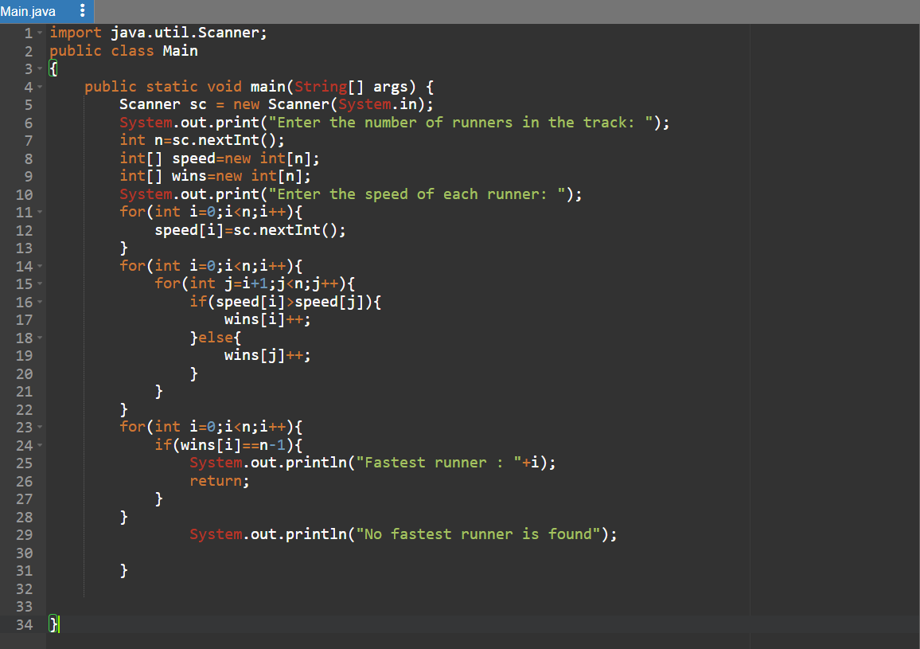
CODING

Slide 6
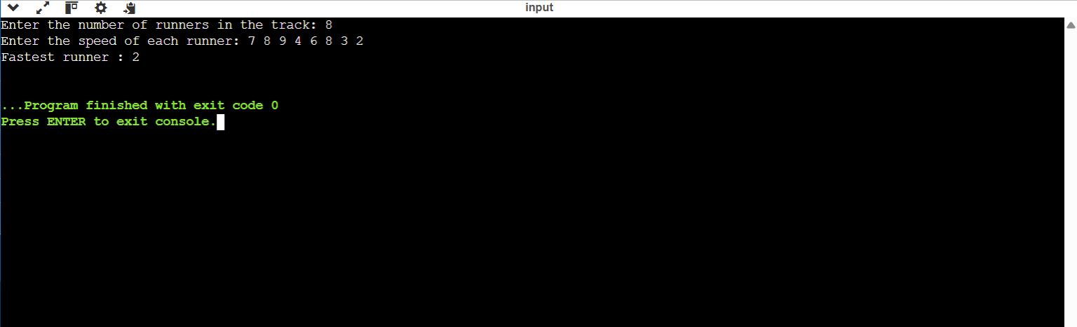
OUTPUT SCREENSHOTS

Slide 7
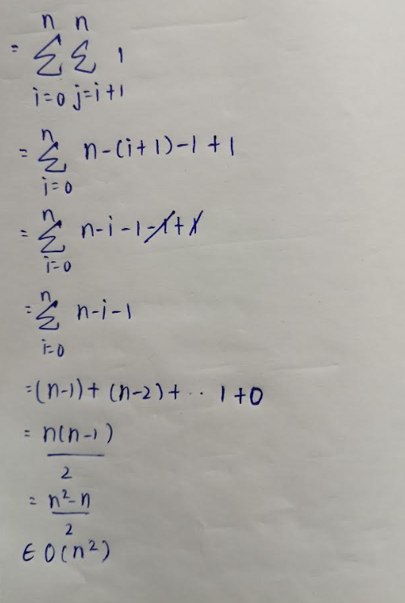
TIME COMPLEXITY - DERIVATION
Total Comparisons:
Basic Operation: Comparison

Slide 8
CONCLUSION
The algorithm uses brute force pairwise comparison
It guarantees correct result by checking all possible pairs
The fastest runner is identified as the one with (n − 1) wins
Limitation
Not efficient for large inputs due to O(n²) time
Number of comparisons increases rapidly as n grows

Slide 9
THANK YOU

